Slide 1
CAPSTONE PROJECT
ON IMDB SENTIMENT ANALYSIS

Slide 2
AIMS & OBJECTIVES
Based on public review , we will perform sentiment analysis.
Also, We’ll try to generalize the emotion of public towards the movie.

Slide 3
Problem Statement
whether the expressed opinion in a document, a sentence or an entity feature/aspect is positive or negative.

Slide 4
Dataset Description
review: expressed opinions by the viewers of the movie
Sentiment: whether the reviews are positive or negative

Slide 5
Import Libraries
import numpy as np
import pandas as pd
import matplotlib.pyplot as plt
import seaborn as sns
import os
import warnings
warnings.filterwarnings("ignore")
import re
from bs4 import BeautifulSoup
from tqdm import tqdm
from nltk.stem import WordNetLemmatizer
from sklearn.model_selection import train_test_split
from sklearn.metrics import accuracy_score,f1_score, confusion_matrix
from PIL import Image

Slide 6
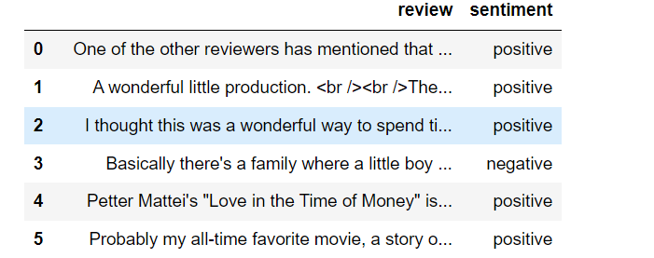
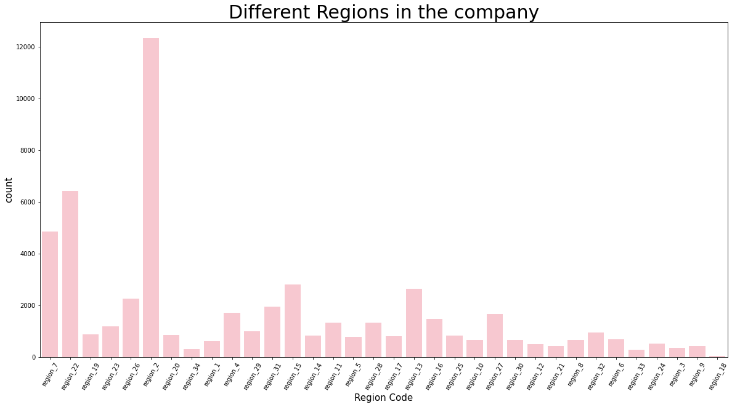
First 5 public reviews and their sentiments:-

Slide 7
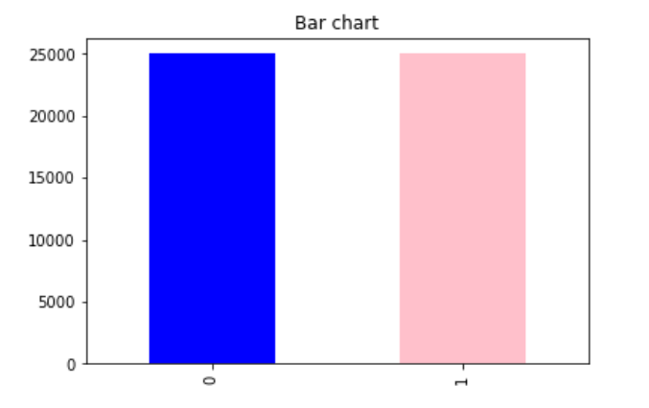
Bar graph representing the count for each class:-

Slide 8
Pre-processing
A real-world data generally contains noises, missing values, and maybe in an unusable format which cannot be directly used for machine learning models. Data preprocessing is required tasks for cleaning the data and making it suitable for a machine learning model which also increases the accuracy and efficiency of a machine learning model.
As we can see here that we have 2 values positive & negative , so assigning 1 and 0 to them (positive-1 & negative-0).

Slide 9
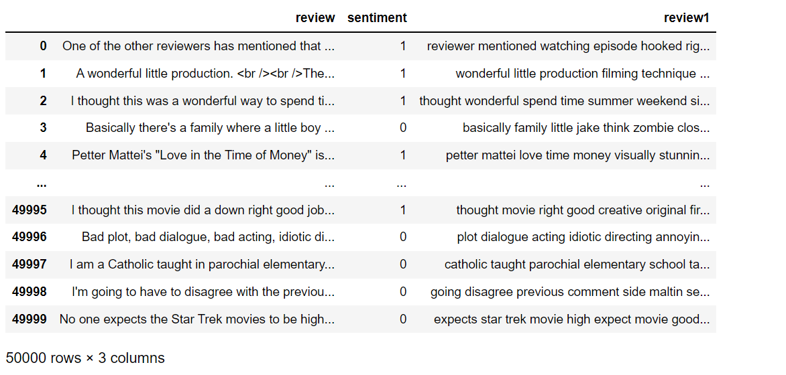
Pre-processing of sentiment column

Slide 10
Data cleaning
Process of clearing punctuation marks in data
Removing website links
Removing html tags
Removing the words with numeric digits
Removing stop words in sentences
Lemmatization
Capitalization to lowercase
Cleaning extra spaces

Slide 11
Splitting the dataset into training & testing
Train size- 35000
Test size- 15000

Slide 12
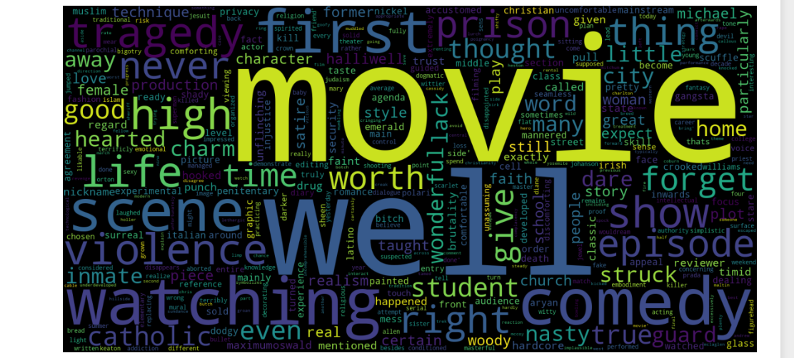
Most important words in whole dataset using word cloud :-

Slide 13
count vectorizer
Count Vectorizer is a great tool provided by the scikit-learn library in Python. It is used to transform a given text into a vector on the basis of the frequency (count) of each word that occurs in the entire text.

Slide 14
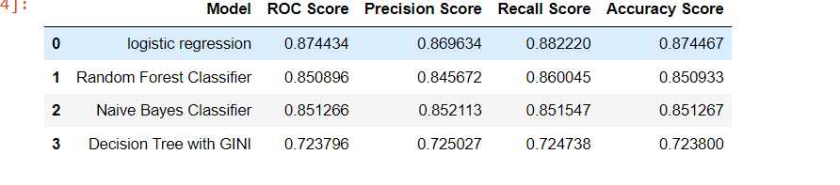
Models comparison

